Slide 1
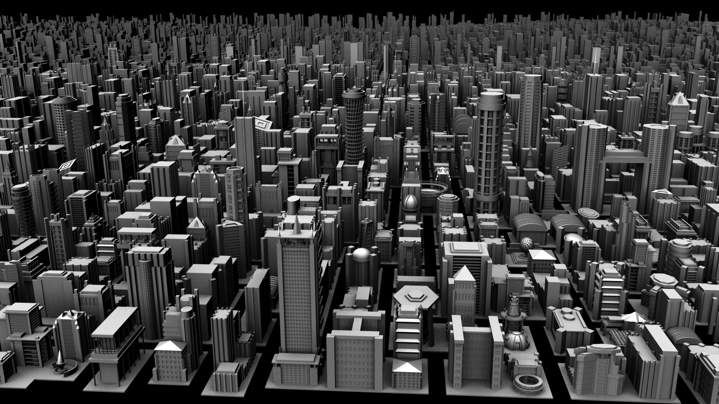

Probabilistic Programming for
Procedural Modeling and Design
Daniel Ritchie
Notes:
Work in the Graphics lab at Stanford
Tell you about a system I built for using PPL to do procedural modeling and design
But to make sense, need to give you some background into how I got into this
And that really starts…

Slide 2
Random Processes in
Computer Graphics
Notes:
…with the long history of using random processes to generate content for computer graphics

Slide 3


[Keyshot]
Notes:
Many of you may have seen or heard of it before
Spatially coherent randomness, usually in 2 or 3 dimensions
Give natural variation to metal, wood textures here

Slide 4

[Terragen]
Notes:
Generate rough, natural-looking terrain

Slide 5
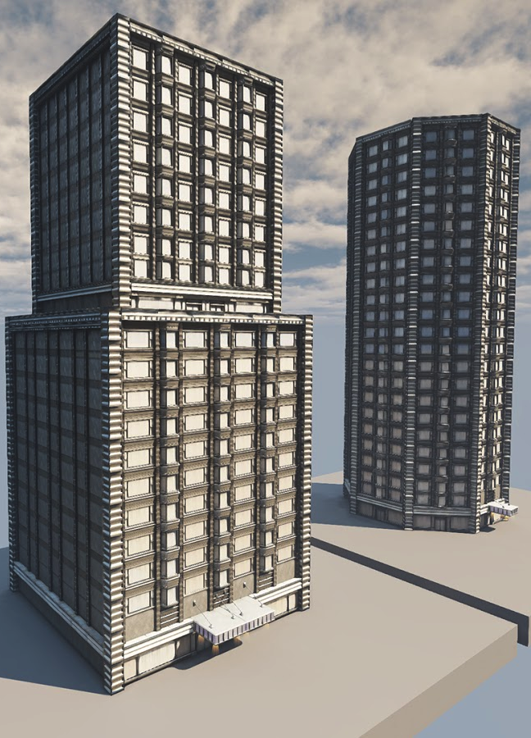

[Unreal Development Kit]
[TreeSketch]
Notes:
Maybe generate random number of floors, random styling for each floor.
Simulate tree growth
Random process decides if and when to branch, size and direction of branches, etc.

Slide 6

[World War Z]
Notes:
Generation motion of large crows of characters
Simulated as independent agents
Inject randomness into agent behavior to create natural appearance.
Randomness not useful for graphics practitioners if it’s chaotic.
Has to be controlled and art-directed.

Slide 7
Directable
Random Processes
Probabilistic Inference
Notes:
A huge chunk of graphics research could be cast as the quest for directable randomness.
Particularly interested in a recent trend that uses inference to do this direction.
Go through some recent examples.

Slide 8
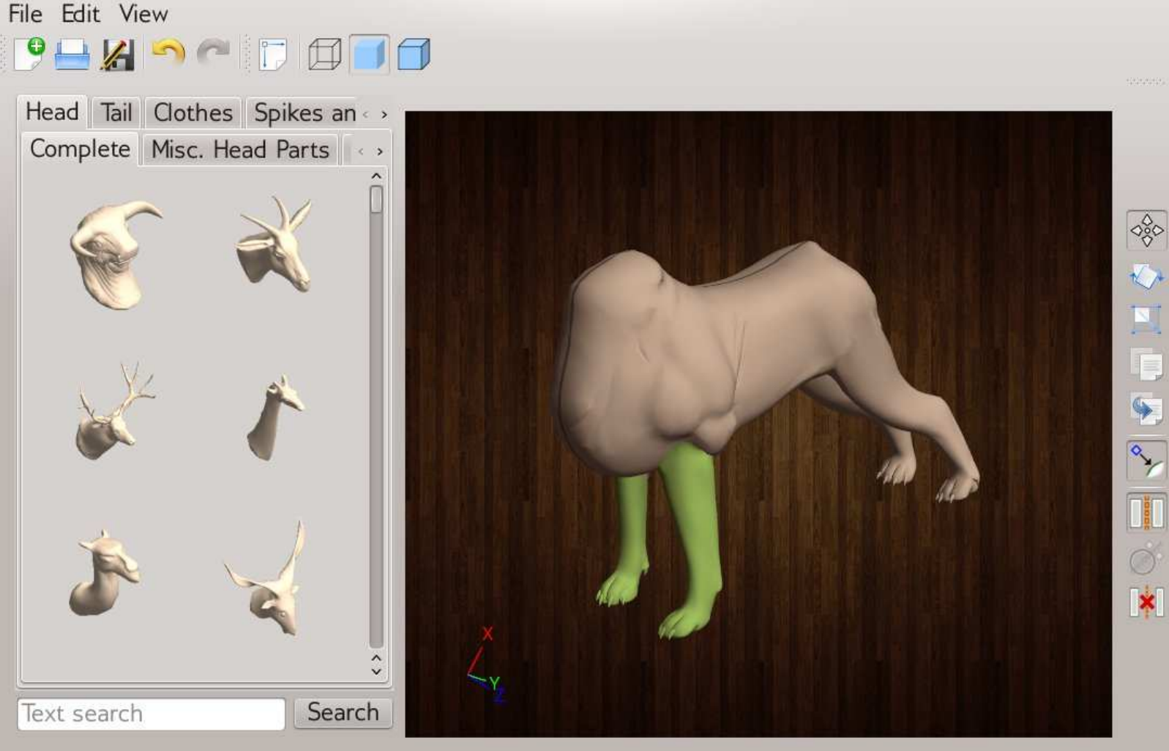
[Chaudhuri et al. 2011]
Notes:
Model that generates random shapes by assembling parts from a library.
Model can be conditioned on shape-so-far, suggesting most likely parts to complete the shape.

Slide 9
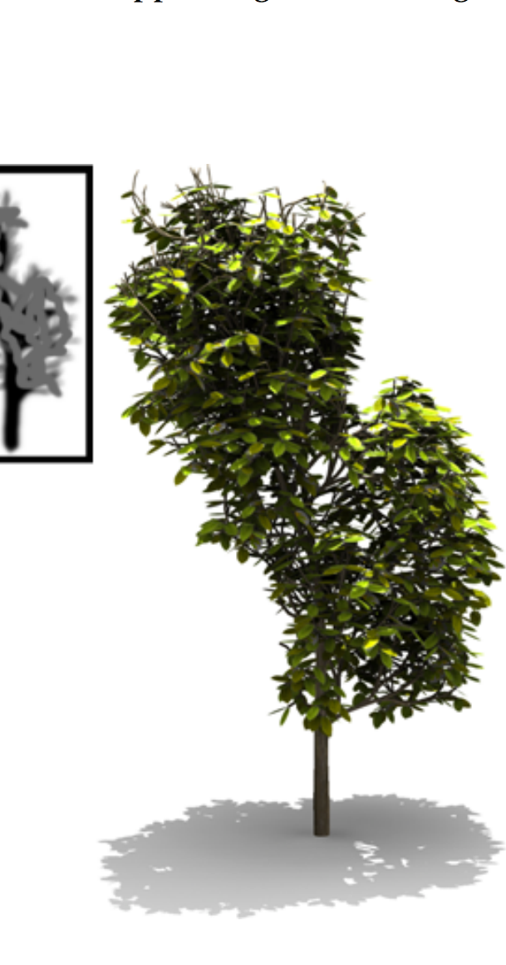
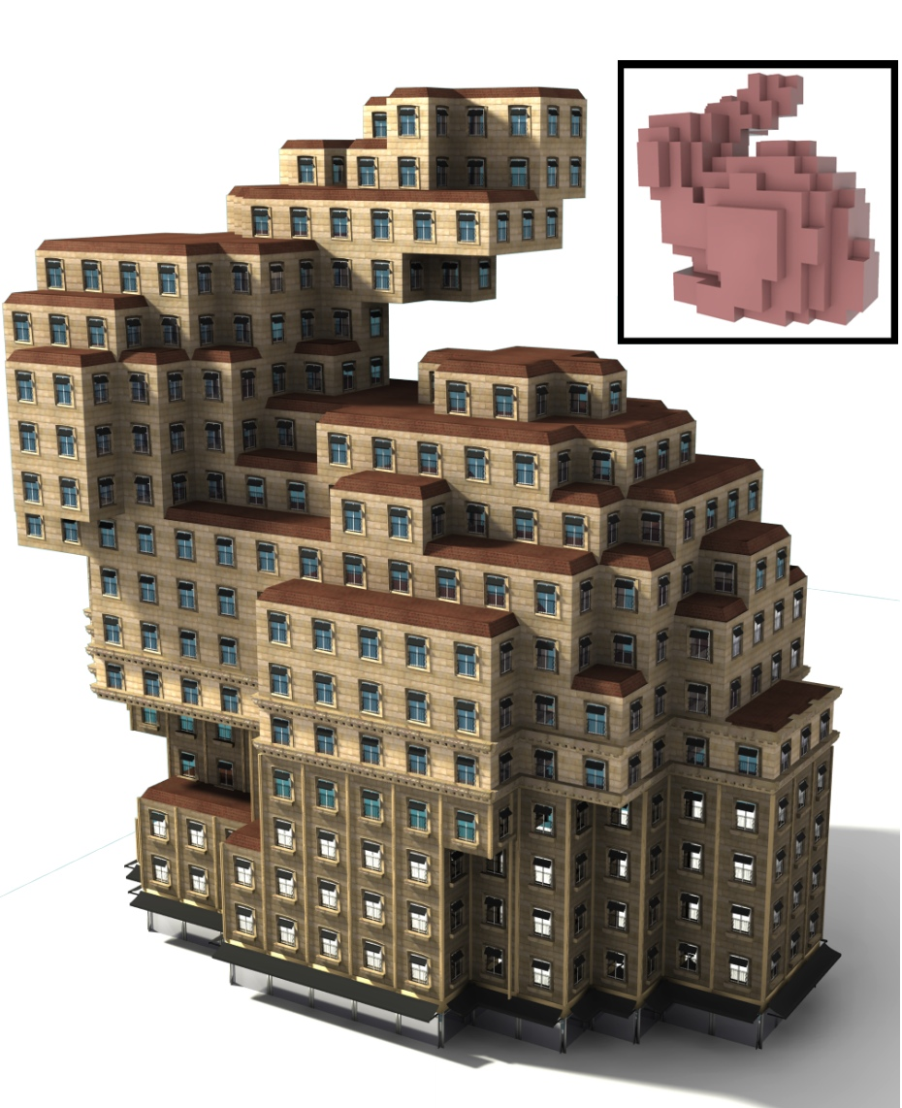

[Talton et al. 2011]
Notes:
Can also condition random shape-generated processes on user-provided images or volumes,
Make trees that look like your scribbles
Make buildings that look like bunnies.

Slide 10
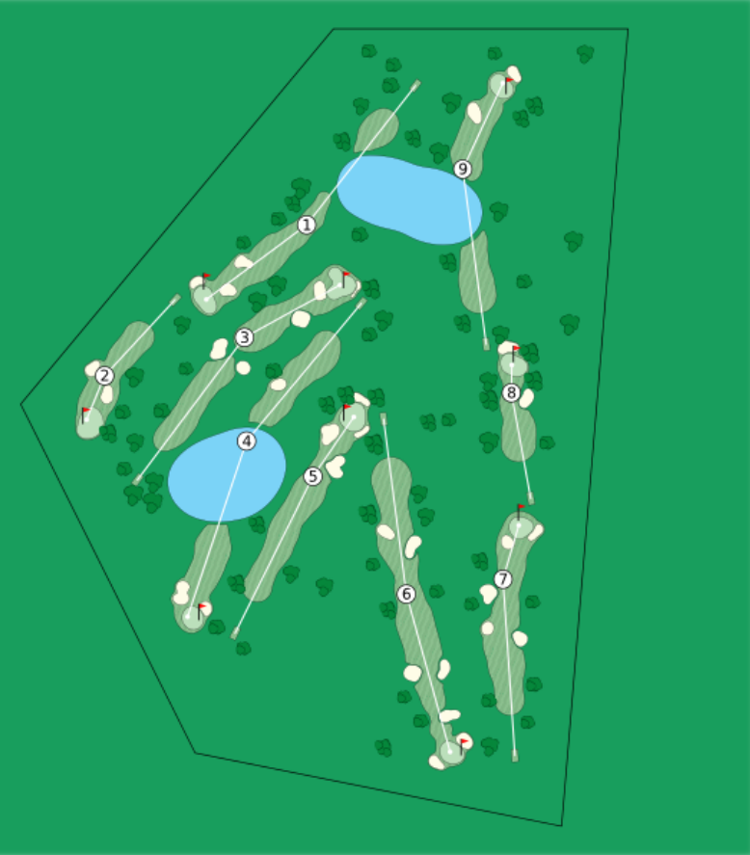
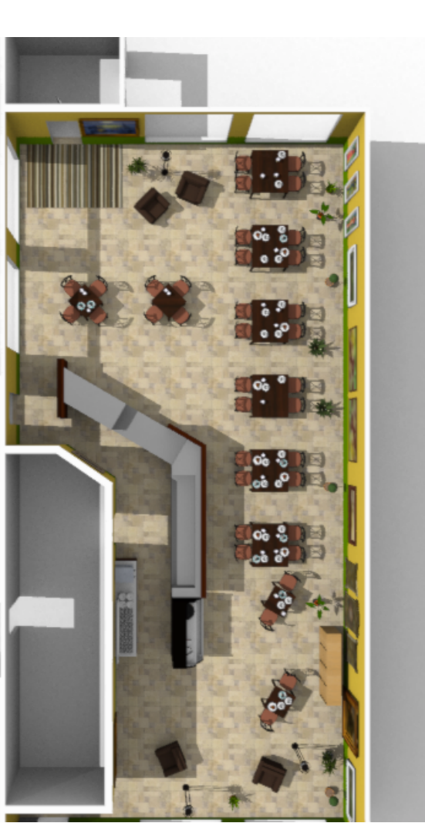
[Yeh et al. 2012]
Notes:
Generate plausible layouts for virtual environments
Process places e.g. groups of tables and chairs
Likelihood specifies non-intersection, enough space for people to walk, alignment, etc.
Can do similar things to generate playable golf courses.

Slide 11


[Lin et al. 2013]
Notes:
Can also condition on aesthetic criteria as well as functional ones.
Generate random colorings of 2d pattern images that respect aesthetic guidelines and look pleasant.

Slide 12
What
(Likelihood)
How
(Generative Prior)
Notes:
Value of inference: separate “how” from “what”
Analogy with “generative prior” and “likelihood”
Procedural vs. declarative knowledge
Sometimes artist intent is easily specified in one form vs. the other
Not easy to specify how to make a tree that looks like the letter W
But can write down a recipe for growing trees…
…and specify what it means for a tree to look like the letter W

Slide 13
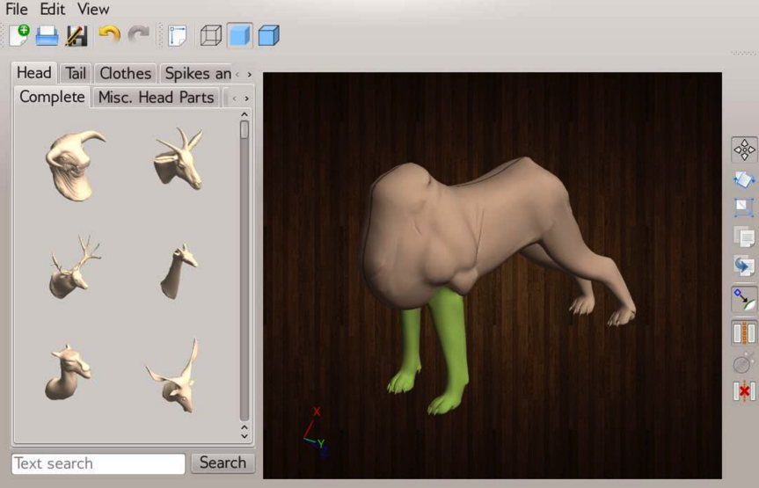
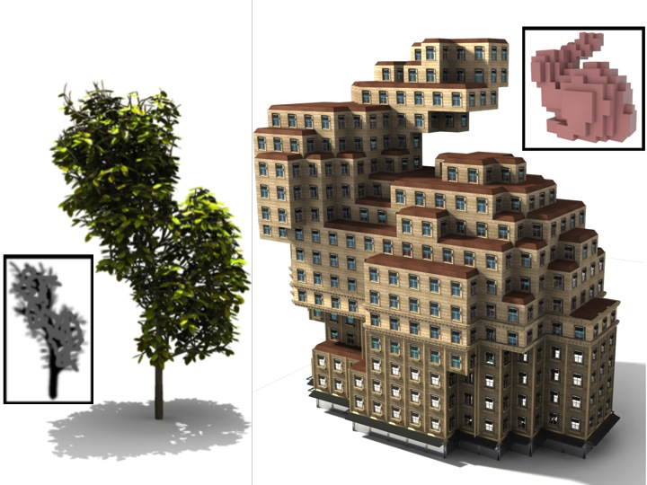
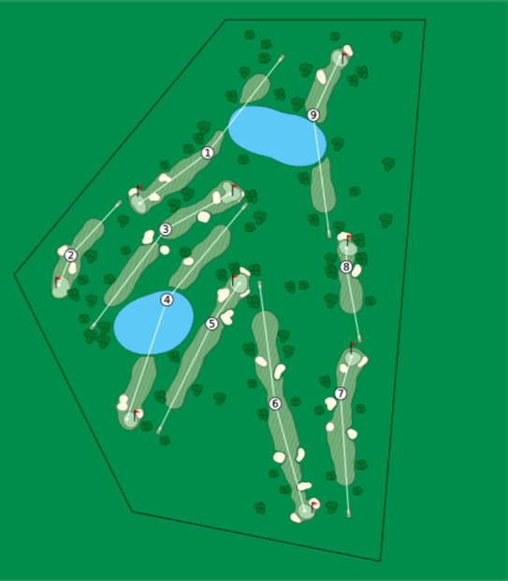
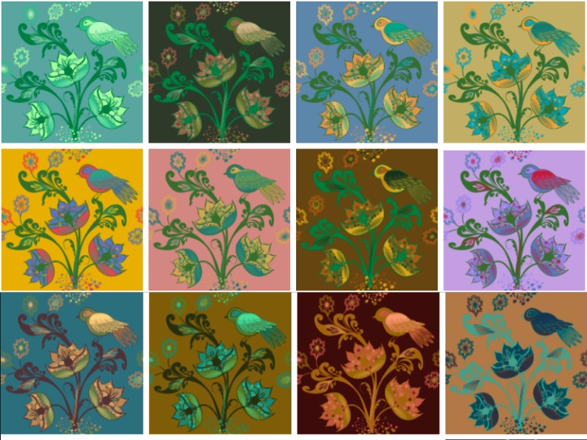
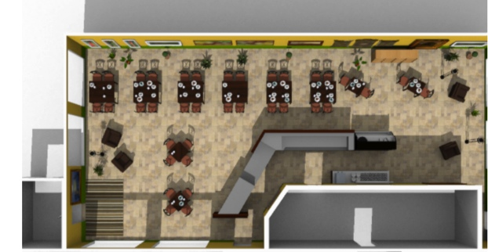
Bayes Net
PCFG
Factor Graph
Factor Graph
Notes:
Examples of inference I showed all use specialized, heavy-duty models (show which)
Results in a lot of one-off systems at SIGGRAPH
Low industry adoption rate (in part because of perceived difficulty of understanding/implementing)

Slide 14
PPL
PPL
PPL
PPL
Notes:
I’ve been interested in using PPLs to do this stuff instead
Technical artists know how to program
But they’re not inference experts
Separating model specification from inference algorithm is perfect for these people.

Slide 15
Language Design Criteria
Imperative
Memory-efficient data structures
Fast
Notes:
Needed to have a testbed language from which to do experiments.
Thought about what properties it ought to.
Here’s some of what I came up with
Criteria:
Allow imperative code (graphics programmers use it)
Memory-efficient representation of data structures (images, meshes)
Fast (efficient machine code)

Slide 16
Quicksand
(A lightweight embedding of PPL in Terra)
Notes:
Idea: embed PPL in a low-level language
Quicksand
Embedded in Terra
Most of you probably don’t know Terra
Quick detour to give short overview of Terra and why it was a good embedding target.

Slide 17

Terra Overview
-- Primitive types
int, bool, double, &int, ...
-- User-defined aggregate types
struct Foo { value: int }
-- Functions
terra min(a: int, b: int) : int
if a < b then return a
else return b end
end
-- C compatibility
C = terralib.includec("stdio.h")
C.printf("Hello, world!\n")
Notes:
Terra: low-level systems prog lang with similar programming model to C.
In fact, so similar to C that it’s backwards-compatible with it.
What makes it so appealing for embedding: use Lua to enable powerful metaprogramming.

Slide 18
Metaprogramming Terra:
Type Parameterization
-- 'Plain' type
struct GreyscaleImage {
data : &float
width : int
height : int
}
-- Parameterized type
function Image(PixelType)
return struct {
data : &PixelType
width : int
height : int
}
end
Notes:
One example of metaprogramming.
Like C++ template classes. Here we get to use Lua, a complete language, instead of a restricted template definition language.

Slide 19
Metaprogramming Terra:
Code Generation
function lerp(lo, hi, t)
-- ` (quote) creates Terra expressions
return `(1.0 - t)*lo + t*hi
end
terra bilerp(x00: float, x01: float, x10: float, x11: float,
u: float, v: float)
-- [] (escape) splices in Terra expressions
var x0 = [lerp(x00, x01, u)]
var x1 = [lerp(x10, x11, u)]
return [lerp(x0, x1, v)]
end
-- Calling bilerp causes it to typecheck and compile
result = bilerp(0.1, 0.4, 0.2, 0.2, 0.5, 0.5)
Notes:
Example that we use all the time in the Quicksand implementation: using arbitrary computations to generate new Terra code.
Imagine we want to write bilerp.
Do this in terms of single lerp.
But I’ll actually write a function that generates the *code* that performs lerp.
Can splice this code into other code using escape.

Slide 20
Metaprogramming Terra:
Code Generation
function lerp(lo, hi, t)
-- ` (quote) creates Terra expressions
return `(1.0 - t)*lo + t*hi
end
-- Generates untyped AST
terra bilerp(x00: float, x01: float, x10: float, x11: float,
u: float, v: float)
-- [] (escape) splices in Terra expressions
var x0 = (1.0 - u)*x00 + ux01
var x1 = (1.0 - u)*x10 + u*x11
return (1.0 - v)*x0 + v*x1
end
-- Calling bilerp causes it to typecheck and compile
result = bilerp(0.1, 0.4, 0.2, 0.2, 0.5, 0.5)
Notes:
Result of splice looks like this
When this is all finished running, we have an untyped AST for bilerp.
First time we call it, typechecks and compiles

Slide 21
Code Gen for Variable Addressing
var x = qs.gaussian(0.0, 1.0)
__trace.address:push(0)
var tmp =__trace.lookup(
GaussianType, 0.0, 1.0
)
__trace.address:pop()
in
tmp
end
Notes:
We use this everywhere in QS impl.
Example: QS is a lightweight embedding, we use it for lightweight address transform.
Call to gaussian random choice primitive actually generates…

Slide 22
Code Gen for Variable Addressing
var x = let
__trace.address:push(id)
var tmp =__trace.gauss_lookup(
0.0, 1.0
)
__trace.address:pop()
in
tmp
end
Notes:
…this code
Push new address onto address stack
Look up whether we have a gaussian RC at this address in our trace of random values
Pop address.
Happens at compile-time, so id can be a lexically-unique identifier (which is critical)

Slide 23
Static Compilation Challenges
P
?
Type
Members
Random
Choice
Calls
Trace(P)
Notes:
Because it’s low level, QS impl uses types with statically-determined type layout, static function dispatch everywhere.
Part of what makes it fast, but it also causes some compilation challenges.
For prob prog P, we also have an object of type Trace(P) for storing and looking up random choice values.
If we’re compiling P, P refers to members of Trace (i.e. trace.lookup), so we need to compile Trace
But to determine Trace members, we need to know the types of all random choices calls in P, which requires compiling P
Need to break this cyclical dependency somehow

Slide 24


Two-Pass Compilation Approach
Pass 1
Pass 2
P
Trace(P)
P
[T1, T2, …]
Trace(P)
P
Notes:
Two pass approach.
First: compile source of P, but random choice calls don’t expand—they just record their type into a list.
Second: Feed this list into Trace(P) source to determine its members and compile it to object code.
With compiled Trace available, can finally compile P to object code.
Little bit more intricacy which is discussed in the paper
Neat: All of this can be done through writing Lua/Terra code
No need for special source-to-source compiler
QS is just a library in Terra
Use by just importing one module

Slide 25
QS Example: Linear Regression
qs = terralib.require("qs")
-- Model definition
linreg = qs.program(function()
return terra()
-- The data
var xs = array(0.0, 1.0, 2.0, 3.0)
var ys = array(0.0, 1.0, 4.0, 6.0)
-- Parameters
var m = qs.gaussian(0.0, 2.0)
var b = qs.gaussian(0.0, 2.0)
var v = qs.gamma(1.0, 1.0)
-- Condition on all the provided data
for i=0,4 do
qs.gaussian.observe(ys[i], m*xs[i]+b, v)
end
-- Predict the value at x=4
return m*4.0 + b
end
end)
-- Query the model for the MAP prediction
queryfn = qs.infer(linreg, qs.MAP, qs.MCMC(qs.TraceMHKernel()))
print(queryfn()) -- output: 8.024
[forestdb.org]
Notes:
Note this is taken from forestdb

Slide 26
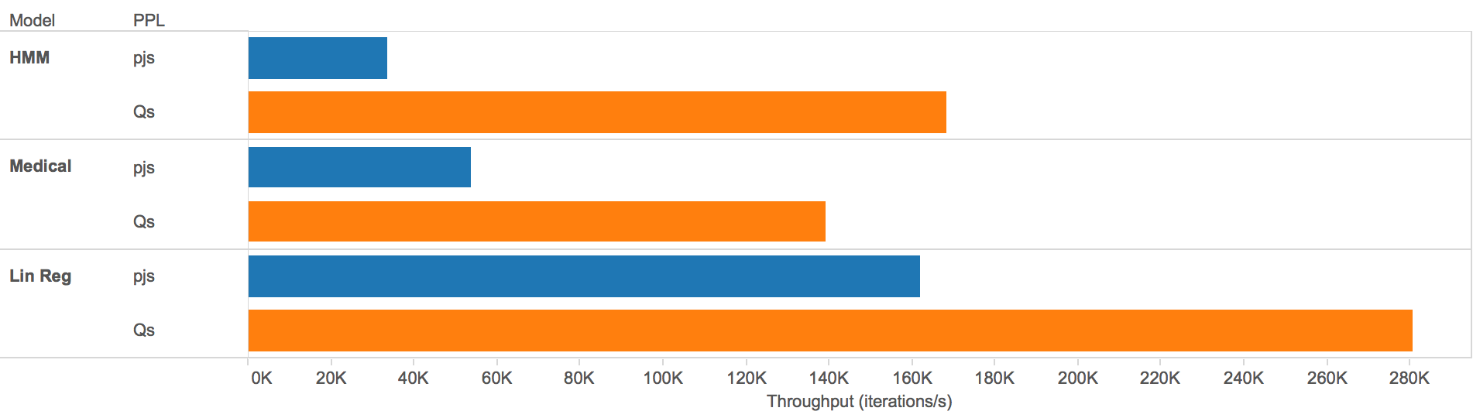
Quicksand has higher MH throughput than Probabilistic-JS
Notes:
Result of all this work is that things are faster (In terms of MH proposals per second)
On HMM, Medical, Lin Reg (from forestdb.org)
As much as 5x faster
These programs use simple data structures (lists, at most)
Expect performance gap to be even bigger w/ images, meshes, etc.

Slide 27
Caveats
Lightweight MH Asymptotics
Low-Level Language Pitfalls
Notes:
Are some drawbacks
Is a lightweight embedding, so it has the asymptotic complexity of lightweight MH
Have to re-execute program on every proposal.
Some interpreted systems do a much better job at incrementalizing proposal computation.
Interested in possibility of incrementalizing a compiled implementation without having to recompile (the slices).
If anyone’s working on it, love to hear it.
Low-level:
Not type-safe
Manual memory management
Can write programs that segfault

Slide 28
Structural vs. nonstructural
HARM and HMC
LARJ

Slide 29
Procedural Modeling Applications
Notes:
But, can do some really cool stuff with it.

Slide 30
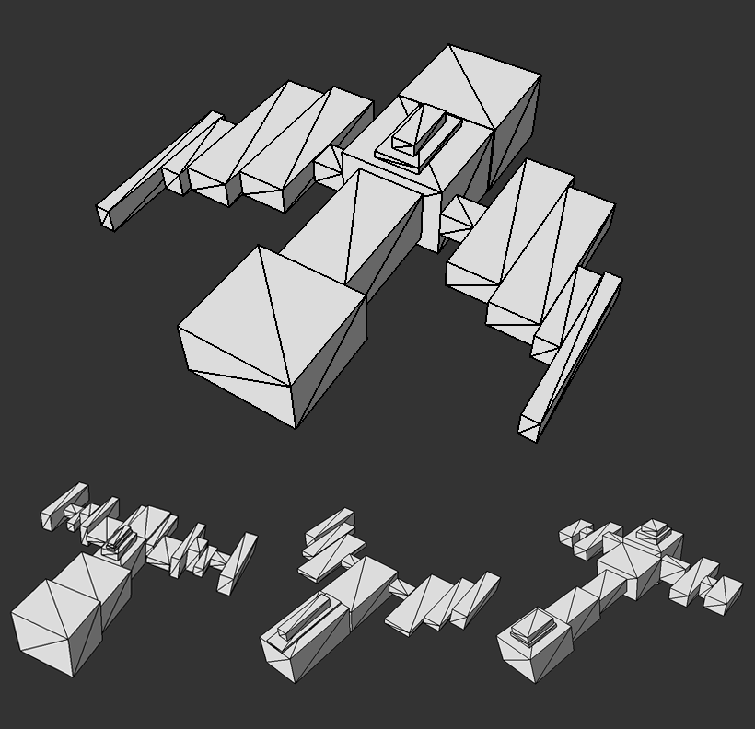
Spaceships – Aspect Ratio
Notes:
Write program to make random ships out of boxy geometry.
Constrain shape by, say, conditioning on roughly square aspect ratio.
Lots of variety while still respecting constraint.

Slide 31
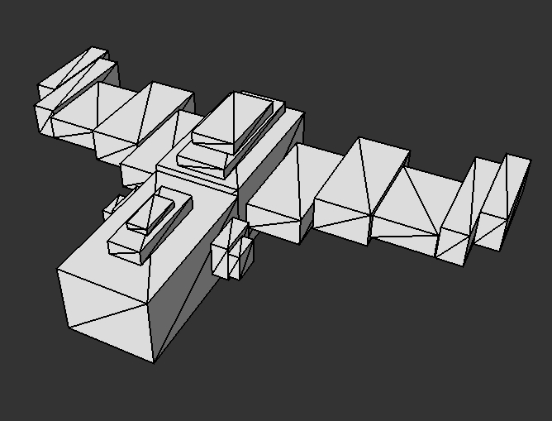
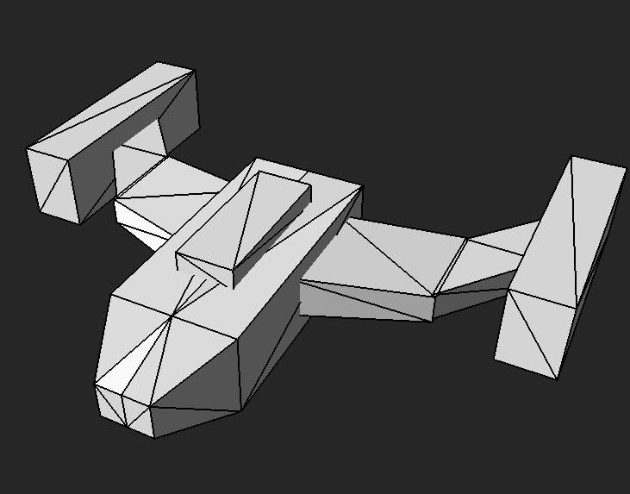
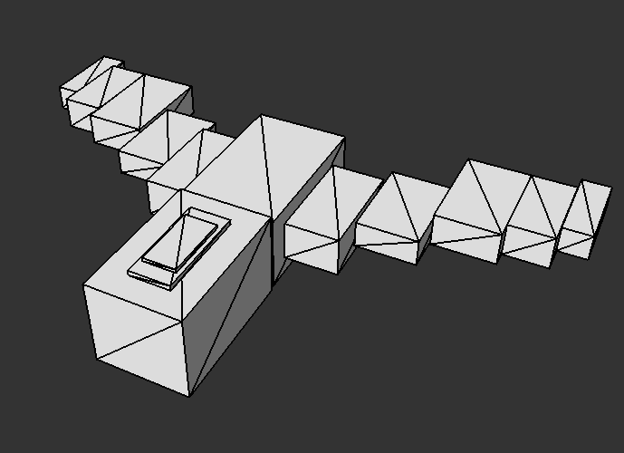
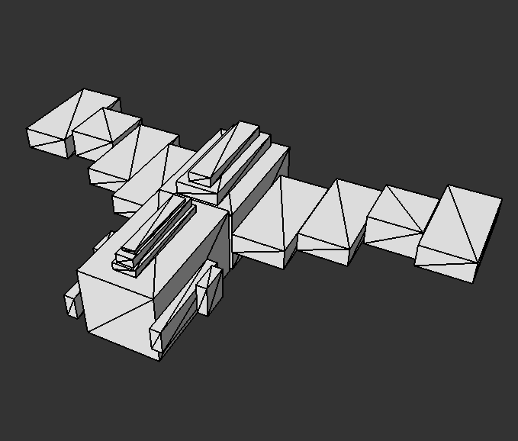
Spaceships – Volume Target
Notes:
Can do more advanced shape constraints.
“I want my ship to look roughly like this”
In the sense that it should match this shape volumetrically.
Can still get some interesting variety.

Slide 32
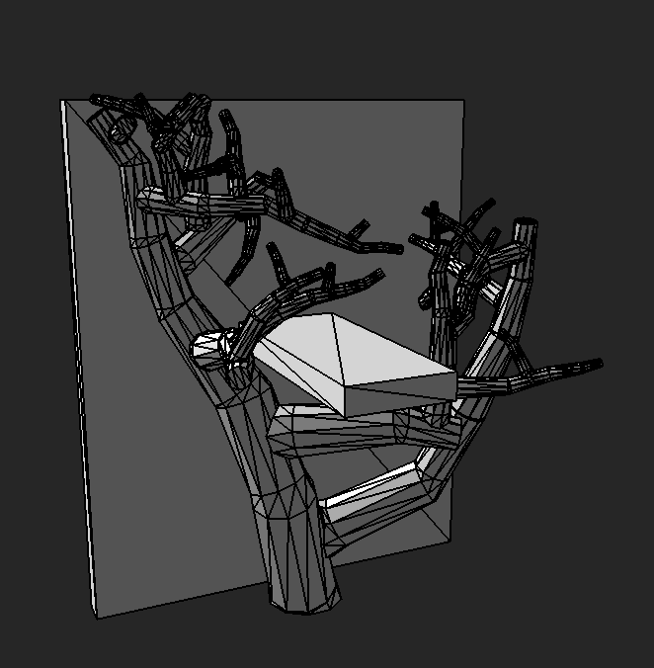
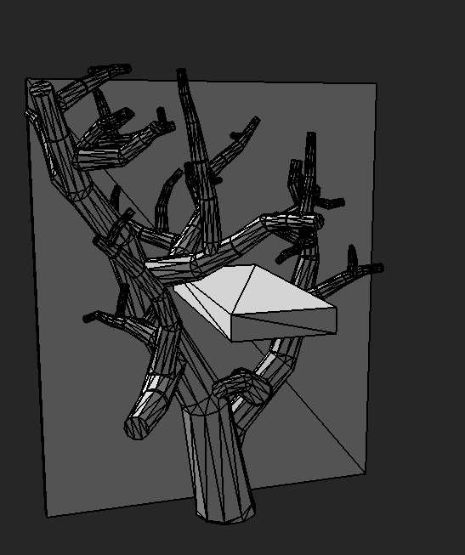
Trees – Obstacle Avoidance
Notes:
In addition to specifying what a shape should look like,
Can also say what it *shouldn’t* look like
Here we generate trees conditioned on not colliding with objects in the environment.

Slide 33

HMC for Stable Structures
Notes:
Can also generate physically-stable objects, too.
Static equilibrium condition expressed as a likelihood.
Strongly couples variables, so we use HMC (which QS includes).
Explore space of possible stable structures that can be generated.

Slide 34
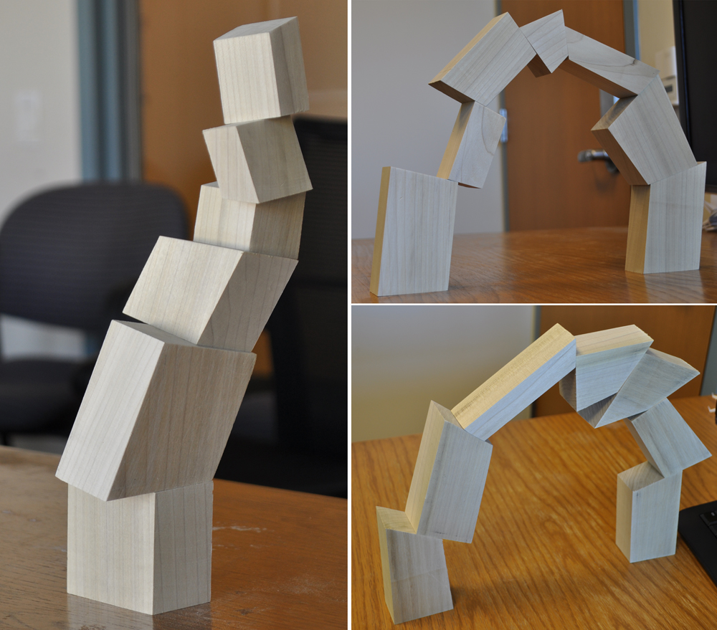
Notes:
Went and built some
To verify that they do actually stand
And because it’s cool ☺

Slide 35

What’s Next?
Alternative Inference Algorithms
Interactivity
Notes:
Lots of interesting recent work on SMC and PMCMC
Embed in interactive tool
Rather than use as offline sample generator
See what happens when part of iterative design process
Tasks such as “debugging” may take on interesting and new meaning in this context
Work with Pixar to find ways to get PPL into their production pipeline.

Slide 36
Notes:
Nominally a talk about a system, and I hope I’ve given you a good introduction to Quicksand…
…but if there’s one thing I hope that you take away from this talk, it’s that…

Slide 37

PPLs for creative tasks…
…as well as analytical ones
Notes:
And if we can keep this in mind as we move forward with building the next gen of PPL tools and systems,
I’m excited for what the future holds.

Slide 38


Thanks!
dritchie.github.io/quicksand

