Slide 1


Slide 2

PRONOUNS
Prepared by:
Dipak. V. Parikh.

Slide 3
Pronoun
Pro + Noun
In place of Naming word
He is reading Mahesh is reading

Slide 4
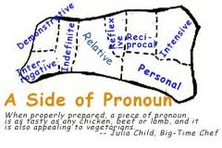
Kinds of Pronouns
------------------------------------------------------
(1)Personal Pronoun
(2) Relative Pronoun
(3) Interrogative Pronoun
(4) Demonstrative Pronoun
(5) Distributive Pronoun

Slide 5

(6) Indefinite Pronoun
(7) Reflexive Pronoun
(8) Emphatic Pronoun
(9) Reciprocal Pronoun
(10) Exclamatory Pronoun
(1) Personal Pronoun: Pronoun that indicates person is called a Personal Pronoun. Example:- He, She, It, We, You, they etc.

Slide 6

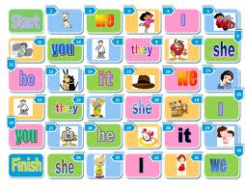

Slide 7
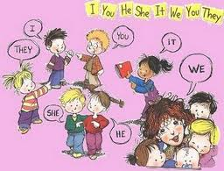

Slide 8

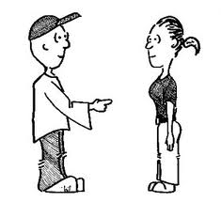

Slide 9
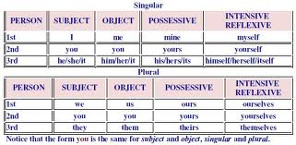

Slide 10
Person Number Subject Object Possessive Reflexive
1st Person Singular I Me My/Mine Myself
Plural We Us Our/Ours Ourself
2nd Person Singular You You Your/Yours Yourself
Plural You You Your/Yours Yourself
3rd Person Singular He Him His Himself
She Her Her Herself
It Its Itself
Plural They Them Their Themselves

Slide 11
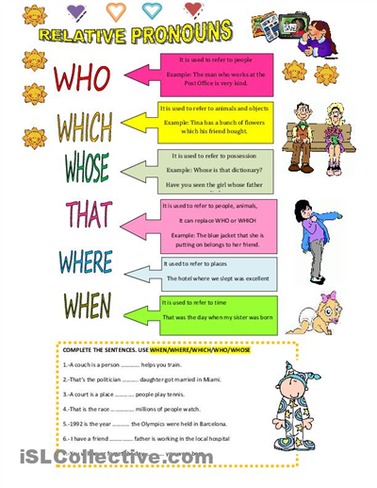

Slide 12
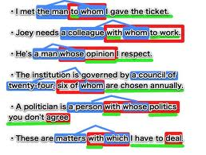
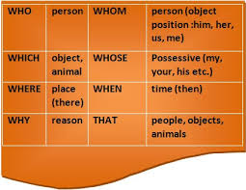

Slide 13
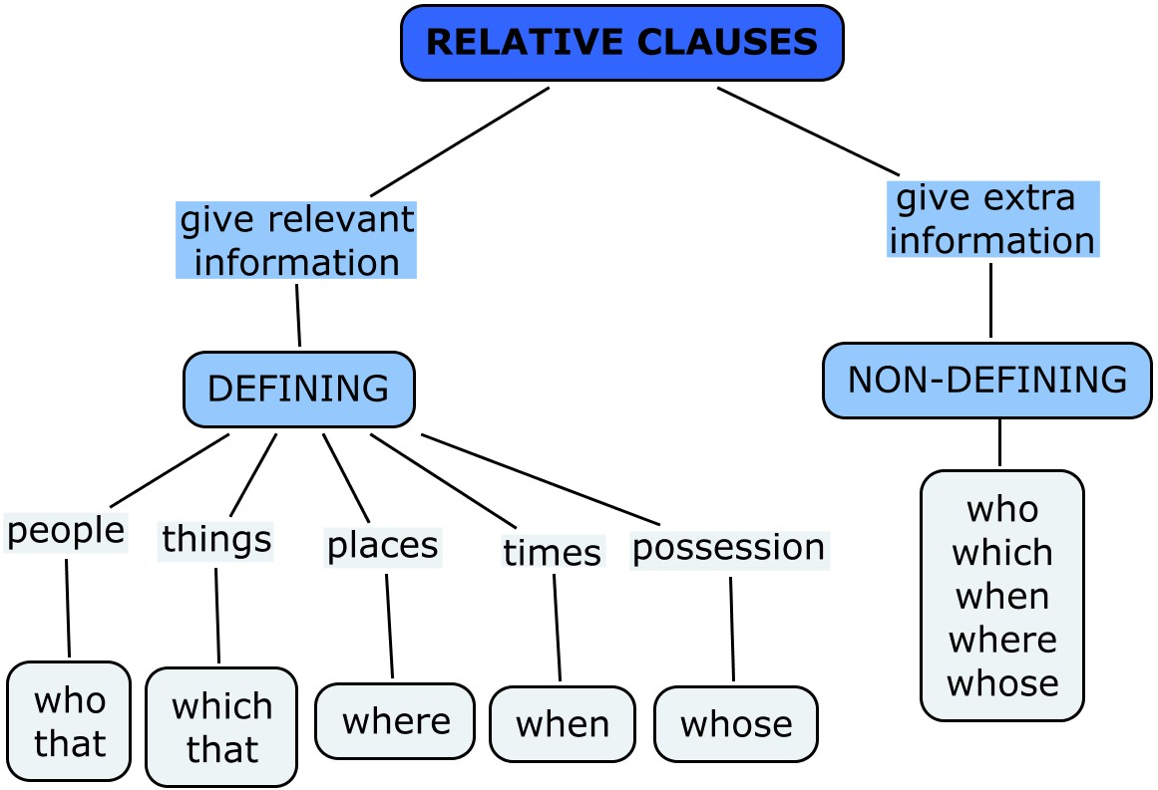

Slide 14
(2) Relative Pronoun:- A Pronoun which shows relation is called Relative Pronoun.
Example: (a) the girl, whom you met yesterday was my sister.
(b) The pen, which you have taken, is mine.
(c) This is the lady whom everybody praises.
(3) Interrogative Pronoun:- A Pronoun which asks a question is called an Interrogative Pronoun.

Slide 15
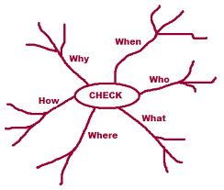

Slide 16
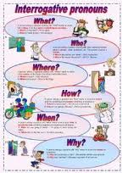
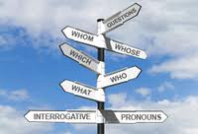
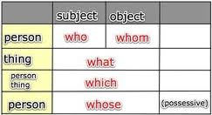

Slide 17
Who won the match?
Which is her pen?
Whom does he hate?
Which of these book do you like?
Interrogative Pronouns have been underlined above.
(4) Demonstrative Pronoun: A Pronoun demonstrates a Noun, an object, a Complement, etc. is called a Demonstrative Pronoun.

Slide 18
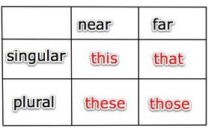
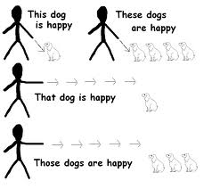
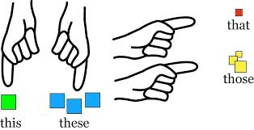

Slide 19
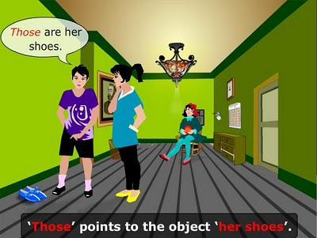

Slide 20
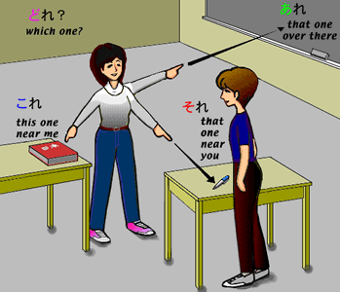

Slide 21
Example:(1) This is your result. (2) That was a silly mistake. (3) These are my books.
(4) Those were my friend’s books.
(5) Distributive Pronoun: A Pronoun which distributes a group or a pair is called a Distributive Pronoun. Each/Every/Either/Neither/Anyone/None/etc. are Distributive Pronouns.

Slide 22
Here's a list of pronouns of this type...
each - "From each according to his ability, to each according to his need."
either - You may answer either of these (two) questions first.
neither - Neither of the answers is correct.
any - You may bring any of your friends.
none - None of our students failed last year.

Slide 23
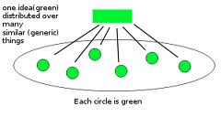

Slide 24
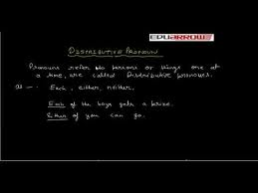

Slide 25
Distributive Pronoun: replaces nouns that are taken one at a time, always take a singular verb.
There are three distributive pronouns:
1) each: refers to all of two more nouns
Example: Each of the desks needs to be cleaned.
2) either: refers to two nouns, one or the other of the two
Example: You can use either of them.
3) neither: refers to two nouns, not one nor the other of the two
Example: Neither of my parents has been to Japan.
Sentence Position: see noun.
Level: beginner, intermediate.
Common Learner Difficulties:
1) using a singular verb following a plural noun that may follow the distributive pronoun.

Slide 26
1) Each of these pens will be sold. (2) None of the students can solve it, I shall be-thankful to God. (3) Either of these students must have taken it. (4) Neither of your friends will come. Distributive Pronouns have been underlined.
Note: (of) is often found after Distributive Pronoun.
(6) Indefinite Pronoun: A Pronoun which is indefinite is called an Indefinite Pronoun.

Slide 27
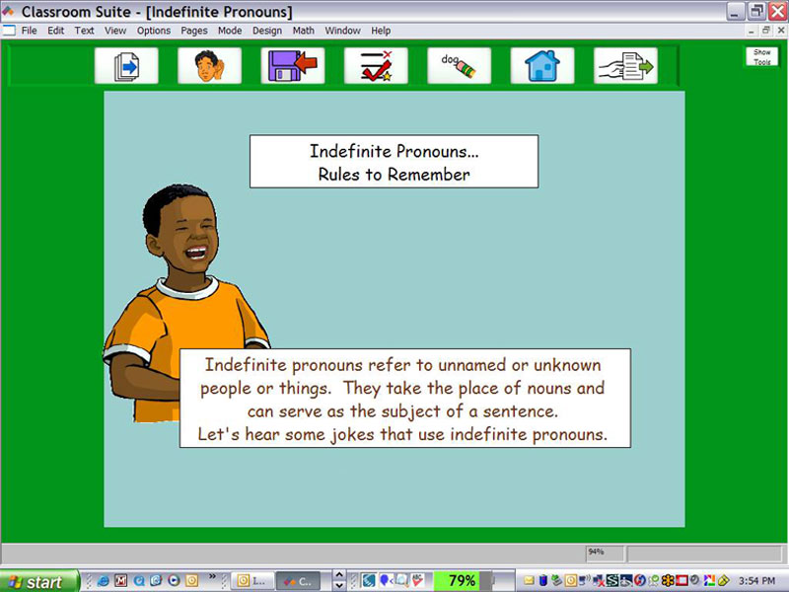

Slide 28
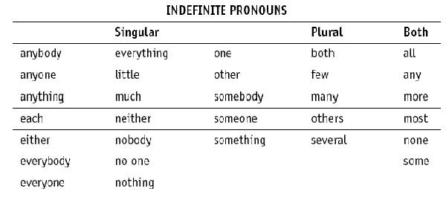

Slide 29


Slide 30
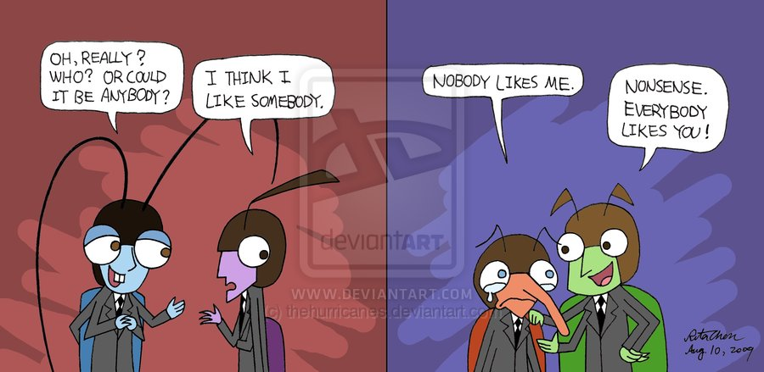

Slide 31
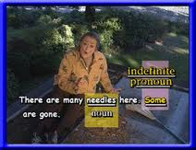

Slide 32
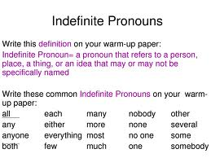
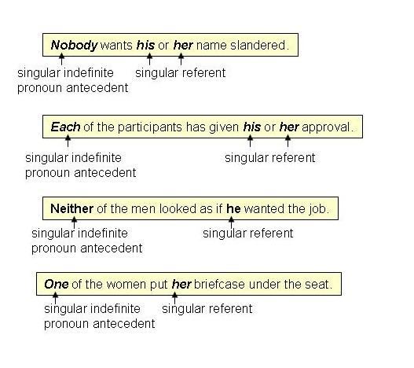

Slide 33
All, Some, One, Many, Few, Somebody, Nobody etc. are Indefinite Pronouns. Ex.
None have come to help you.
A few cab build houses.
One should know one’s job.
Many have been failed.

Slide 34
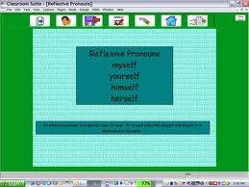


Slide 35
(7) Reflexive Pronoun: A Pronoun which reflects the action towards the subject is called a Reflexive Pronoun. Example:
She hurt herself while playing.
You have invented this machine yourself.
I shall do it myself.
He solved his problem himself.

Slide 36
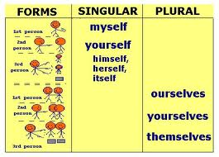

Slide 37
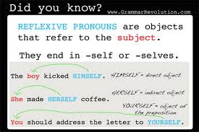

Slide 38
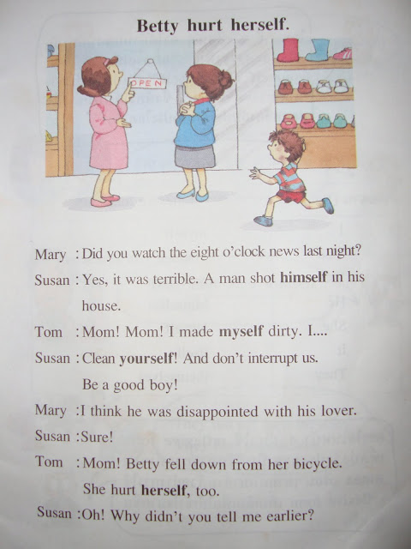

Slide 39
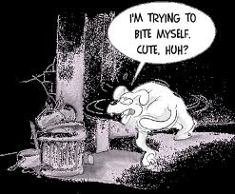
(8) Emphatic Pronoun: A Pronoun which is used for emphasis is called an Emphatic Pronoun.

Slide 40

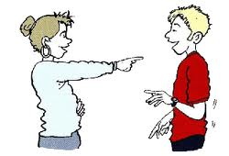

Slide 41
An emphatic pronoun is a reflexive pronoun used to emphasize the antecedent; for example:
(1) I myself made the cookies.
(2) You yourself are a good friend.
(3) They themselves fixed the roof.
(4) He himself made pancakes for breakfast.

Slide 42
(5) I myself is enough to solve the problem.
(6) You yourself will return my money.
(7) He himself knows me very well.
(8) They themselves will have to earn money.
A Reflexive Pronoun is used after the verb but Emphatic Pronoun is used before

Slide 43
-the Verb.
Example:
she did it herself without any guidance.
Verb Reflexive Pronoun
(2) She herself did it in hurry without any-
-guidance.
Emphatic Pronoun

Slide 44
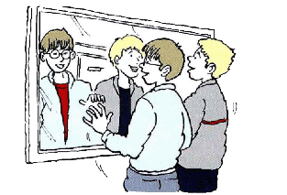
(9) Reciprocal Pronoun: A Pronoun which shows relation with one another is called a Reciprocal Pronoun.

Slide 45
Example.
All the enemies kill one another.
The two girls hate each other.
Rule: (a) Each other is used for two persons.
(b) One another is used for more than two persons

Slide 46

What is a reciprocal pronoun?
You must be well familiar with the verb ‘reciprocate’ which means to give back or give in return. A reciprocal pronoun as such is used when there are two or more individuals involved in the action and when the same is reciprocated.

Slide 47
What is the use of reciprocal pronouns?
What are the things to remember while using reciprocal pronouns?
The phrases ‘one another’ and ‘each other’ are pronominal phrases or reciprocal pronouns that express a mutual relation referring to the subject in the plural. Reciprocal pronouns are used to indicate an action carried out by two persons and so also the consequences experienced at the same time.

Slide 48
What is the use of reciprocal pronouns?
Reciprocal pronouns simplify the meaning of sentences especially where the same idea has to be expressed more than once in a sentence. For example the following sentence, “Paul gave Ann a diamond ring on their engagement ceremony and Ann gave Paul a diamond ring” can be written better using a reciprocal pronoun.

Slide 49
There is no doubt that the following sentence sounds better, “Paul and Ann gave each other diamond rings on their engagement ceremony.”
Another example would make the usage clearer: “Paul and Ann hugged each other.” The reciprocal pronoun ‘each other’ used in the above sentence indicates that both Paul and Ann carrying out the action of hugging got the consequence, ‘hugs’ at the same time.

Slide 50
The reciprocal pronoun ‘one another’ is used when more than two persons are referred to in a given situation. For example as in the following cases, “The boys in this class generally help one another while doing the project.” “The members of the football team congratulated one another on winning the world cup.”

Slide 51
What are the things to remember while using reciprocal pronouns?
The commonly used reciprocal pronouns ‘one another’ and ‘each other’ are not words used individually but are used together as phrases.
The use of a reciprocal pronoun suggests the existence of multiple nouns or a plural noun in the sentence. This is because a reciprocal pronoun requires another person to share the feeling or action.

Slide 52
This is because a reciprocal pronoun requires another person to share the feeling or action.
Reciprocal nouns are used when two or more persons are performing the same the same action or thing.
Reciprocal pronouns should be used when both the individuals are equally responsible for the action or feeling.

Slide 53
Reciprocal pronouns can be used in the possessive form as in this sentence, “Paul and Ann can wear each other’s jacket. Thus by adding the apostrophe‘s’ to the reciprocal pronoun, the meaning is correctly expressed in the possessive form. Here it means that Paul and Ann both have jackets that the other can fit into easily.

Slide 54


