Slide 1
Prepared By: Dipak V. Parikh
Principal,
Vakal Vidyalaya,
Refinary Road, Bajuwa.
Baroda
Importance of English

Slide 2


Slide 3
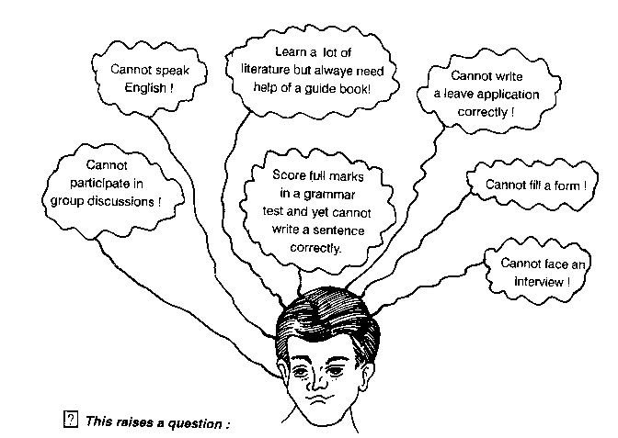

Slide 4
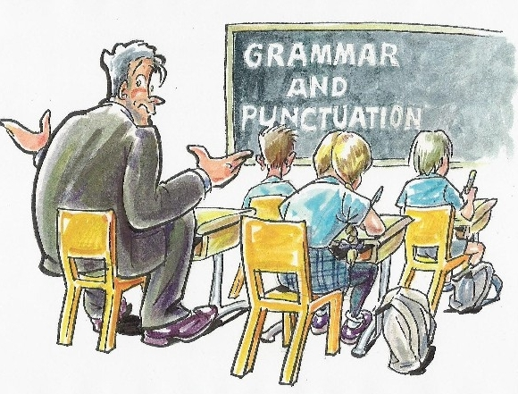

Slide 5
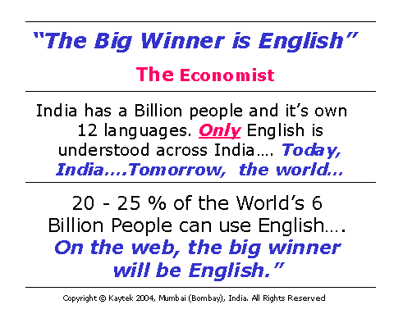

Slide 6
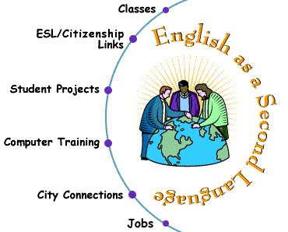

Slide 7
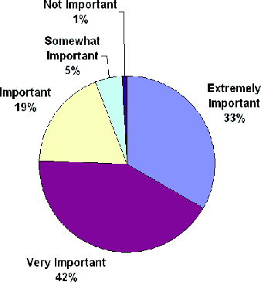

Slide 8


Slide 9
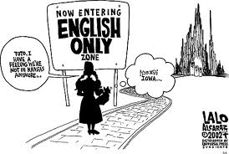

Slide 10
The Origin and Development of English
-More than 105 crore people speak Chinese language whereas nearly 51 crore people speak English.
-Hindi stands third.
-Today the total population of the world increased but the languages and dialects which were spoken earlier have been decreased.
-Many languages and dialects were crushed.

Slide 11
-Engla (wandering) tribe, the language which was spoken by them was Englisc and the land on which they ruled was known as Engla land and the world became England.
-In 1362 A.D. English became the national language of England.
In 1582 A.D. Richard Mvlcaster compiled the first dictionary.

Slide 12
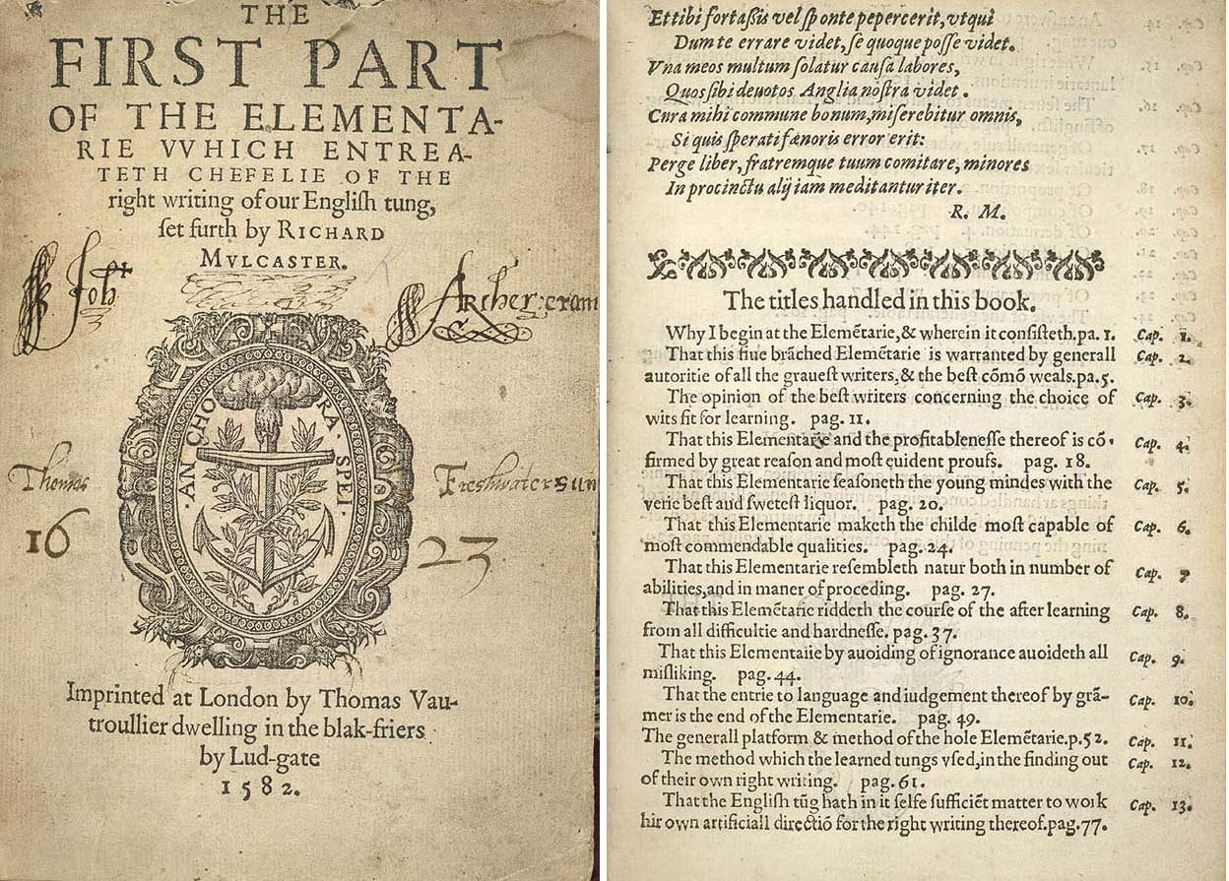

Slide 13
Richard Mulcaster’s guide to learning, entitled Elementarie, was first published in 1582. It was written as an attempt to make the English language and culture more respected and accessible. Until the end of the 16th century, Latin had been the traditional language of learning – English was looked down upon by scholars, and was only thought good enough for popular books and plays.

Slide 14
. By stabilising the language, Mulcaster hoped that English would be recognised by scholars for its richness and vitality. The Elementarie contains a list of 8,000 words, none of which are accompanied by definitions, and therefore the list cannot strictly be classified as a dictionary – there was no such thing as a purely English dictionary at the time. It is, however, an attempt to start to organise the English language.

Slide 15
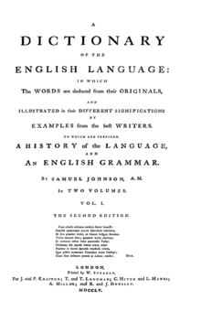
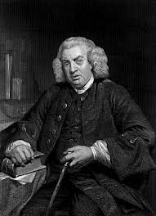
In 1755 A.D. Samuel Johnson prepared a good dictionary.

Slide 16
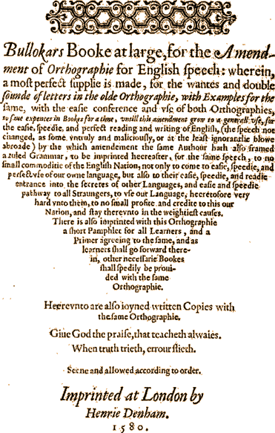
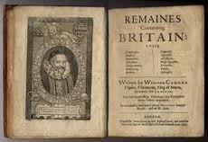
-William Bulloker gave the first English grammar in 1580 A.D.

Slide 17
Importance of English:
In today’s global world the importance of English cannot be denied and ignored
_ English is the most common language spoken everywhere.
-70%programme of T.V. are in English.
-75%posts are written in English.
-Pilots are supposed to speak in English.
-With the development of technology

Slide 18
-In science, technology, medicine, engineering, education it is important or essential.
-The most of datas of science and technology are in English.
The weather forecasting is also in English.
-The results of the latest researches come in India are in English.
Our parliament has also recognized English as an official language.

Slide 19
-English is the language of our constitution, supreme court, high courts and other departments of the central government also.
-For inter state trade and for international trade it is essential.
-Most of the programmes of computer are in English.
-To know the historical and cultural heritage of our country and the other-

Slide 20
-countries English is essential.
-English is now rooted in the soil of our country, it has become the part of our life.
Some of the states have started English medium primary schools.
There is great demand of English medium schools throughout the country.
Many of leaders who denounce English, send their children to English medium-

Slide 21
-Schools.
-We must make the best use of English to develop ourselves culturally and materially so that we can compete with the best in the world of mind and matter.
-English language has opened the window of the world and we are supposed to take advantage of it.

Slide 22
The End

